Slide 1
Orderlimit planner

Slide 2
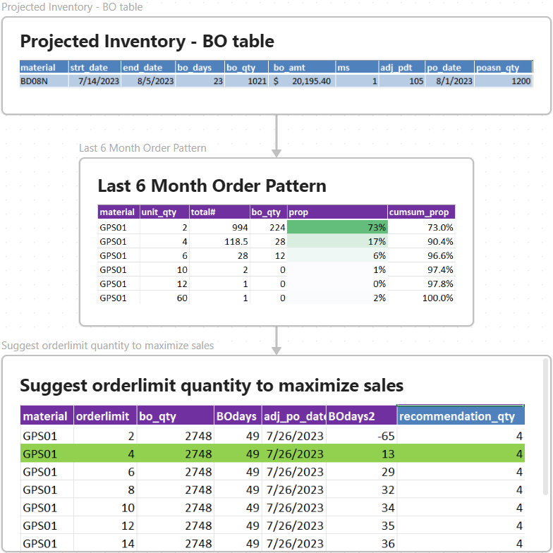
Projected BO from Projected Inventory
material | bo_qty | bo amount$ | period
Last 6 Month Order Pattern
proportions of order unit_qty
Suggest the best order limit quantity which maximizes sales
expect bo_qty, bo amount, bo period under specific orderlimit qty.

